Slide 1
Effects of Healthcare on Employee Performance
Matthew Fein
Fordham Gabelli School of Business
Spring 2019

Slide 2
Introduction
Churn Rate- a measure of turnover
Most commonly used for subscriber based services
If factors which influence churn rate can be identified customer retention rates can be improved

Slide 3
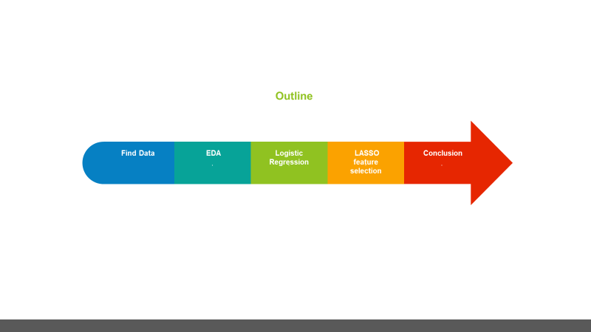
Proposed Methodology

Slide 4

Data description
Original dataset retrieved from Kaggle.com
N= 3333
Original Attributes = 21
Attributes ranged from nominal variables such as phone number to discrete variables such as plan type as well as continuous variables such as minutes used and charges incurred
Interested in whether or not a customer leaves or not (churn or true indicates attrition)

Slide 5
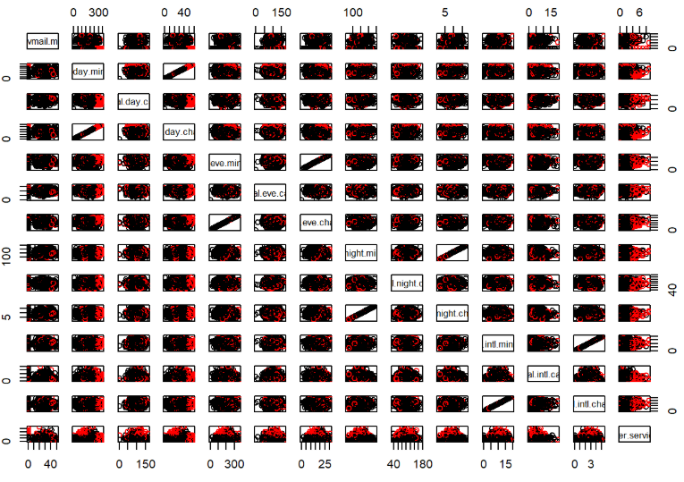
Data description (cont.)
Discrete variables removed
Strong multicollinearity seen between charges
and minutes for day, night and international
Only variables measuring charges were used since
this information may be easier to leverage

Slide 6
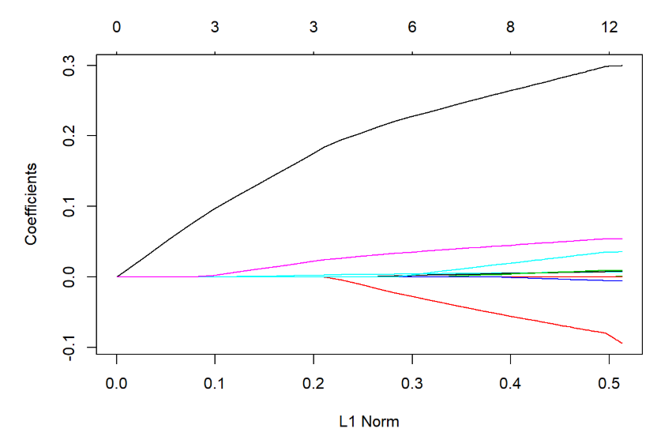
LASSO regression
LASSO = least actual shrinkage and selection operator
Method used for feature selection
Also useful when more attributes than observations (not applicable here)
Regularization of data employed to ease interpretability of results

Slide 7
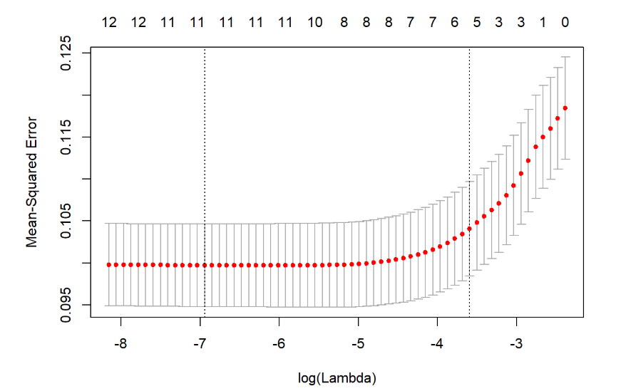

LASSO cont’d
LASSO identified 9 attributes which were most informative
Confusion Matrix
LASSO accuracy was 84.7%

Slide 8

Logistic Regression
Using the variables identified from LASSO a logistic regression was performed
The threshold for churn decision was tuned from 0.5 to 0.8
This was done to more closely mirror real world conditions as there are far less instances of actual churn
This tuned logistic regression achieved an accuracy level of 86%

Slide 9
Conclusions
The attributes of daytime charges, nighttime charges and calls to customer service were the most significant contributors to churn rate.
One suggestion is to offer a premium customer service plan- since more calls to customer service led to a higher likelihood of attrition this may be an attractive option for individuals unhappy with their service.
Another actionable suggestion is to offer plans which offer discounts for day vs. night calls. While this has gone out of style it may be worth revisiting

